Slide 1
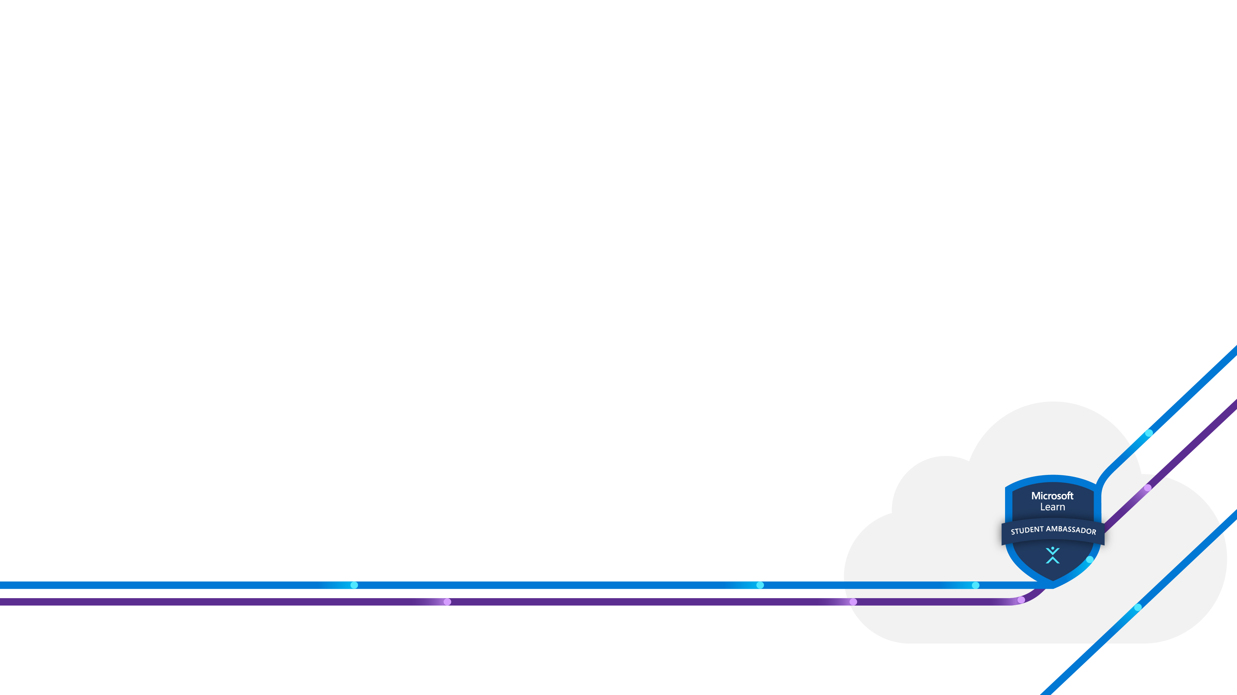


Devansh Shah
Beta Microsoft Learn Student Ambassador
Ex Microsoft Intern
Mentor
Explorer
Microsoft Learn Student Ambassadors

Slide 2
Agenda
Intro to Cloud Computing
Intro To Microsoft Azure
Quiz Time
My Experience

Slide 3
Microsoft Learn
Student Ambassadors
Intro to cloud computing
Microsoft Learn Student Ambassadors

Slide 4
What is Cloud computing?
Cloud computing is renting resources, like storage space or CPU cycles, databases, networking, software, analytics , intelligence etc.
You only pay for what you use. The company providing ​these services is referred to as a cloud provider.​
Microsoft is one of the cloud provider which is AZURE.​
Cloud computing makes running a business easier. It’s cost-effective, scalable, elastic, current, reliable, and secure. This means you’re able to spend more time on what matters and less time managing the underlying details.

Slide 5
The evolution of Cloud computing
1950-66 | 1969-93 | 1995-00 | 2006-07 | Present
1950: Herb Grosch suggested the idea that having 15 large datacentres should suffice the computing needs of the world 1960: John McCarthy proposed the idea of computation being conveyed as public utility 1966: Douglas Parkhill aimed to explain the modern-day characteristic of cloud computing in the book “The challenge of the Computer Utility” | 1969: Advanced Research Development Projects Agency Network (APRANET) has taken its steps to developments. During the same year, UNIX was developed. 1990: Internet age was started 1993: The use of browsers were popularized in accessing the WWW(World Wide Web) | 1995: Online businesses including Amazon and eBay were launched to the public. 1999: Salesforce.com was launched, resulting in one of the first software-as-a-service offerings. 2000: Dot com bubble bursts, forcing companies to cut costs on infrastructure and improve datacentre efficiency and utilization. | 2006: Amazon launches Amazon Web Services(AWS), offering storage services in the form of Amazon S3, and compute resources in the form of Amazon EC2. 2007: Salesforce launched force.com, which is a cloud computing platform as a service system from salesforce.com | Several start-ups launched. Start-ups today leverage cloud computing services in order to reduce capital expenditure and scale rapidly as their service popularity grows.
Ideas | Technologies | Realities

Slide 6
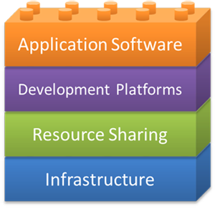
Building blocks of the cloud
We present four main building blocks in cloud computing: application software, development platforms, resource sharing, and infrastructure, The infrastructure includes the physical resources in a datacenter. The resource sharing layer typically entails software and hardware techniques that allow the sharing of the physical resources while offering a certain level of isolation. The development platforms are utilized to develop cloud applications.

Slide 7
Cloud computing services
In a broad sense, cloud services differ based on the needs of different users. This section reviews three popular types of cloud services:
Software as a Service (SaaS)
Product as a Service (PaaS)
Infrastructure as a Service (IaaS)

Slide 8
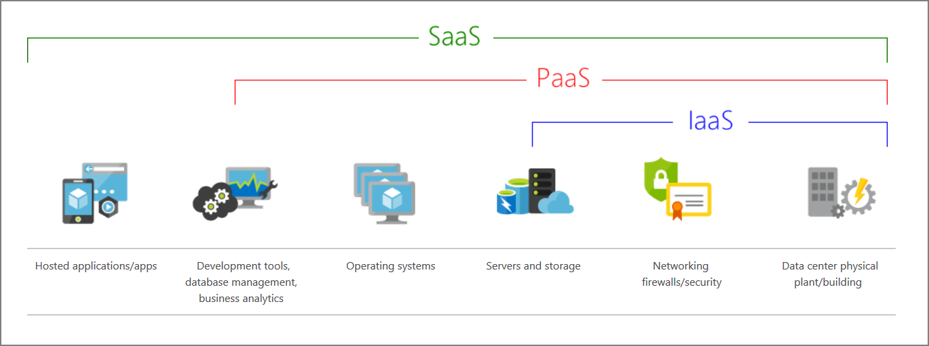
Cloud computing services – The big picture

Slide 9
SaaS examples
Webmail is one of the early examples of SaaS
Can be accessed by a web browser at any time, anywhere
Offerings like Outlook, Yahoo Mail, and Gmail
Based on ‘Freemium’ model
Source of revenue mainly from advertisements that are displayed to the users as they use the service.

Slide 10
PaaS use cases
PaaS is favored for:
Rapid application development scenarios.
Applications that require web-based infrastructure to handle varying loads from users.
Applications that may not need redeployment or migration to other platforms in the future.

Slide 11
PaaS examples
Azure Functions (serveless)
Force.com (cloud IDE)
Google App Engine and AWS lamda ( serveless)

Slide 12
IaaS Characteristics
IaaS has the following characteristics:
Computing resources are provided to IaaS users as a service.
IaaS providers provide tools that enable IaaS users to configure the dynamic scaling of resources.
IaaS providers usually have different resource offerings at different costs and follow a utility pricing model (typically calculated hourly).
The same physical resources are shared among multiple users.

Slide 13
IaaS use cases
IaaS is not favored when:
Regulatory compliance does not allow data to be offshored or outsourced.
Applications have strict quality-of-service (QoS) requirements.
Organizations have existing in-house customized infrastructure to meet their IT needs.

Slide 14
IaaS examples
Azure VMs
Amazon Web Services (AWS)
Google Compute engine
VMware

Slide 15
Types of clouds
There are three well-known deployment models for cloud computing:
Public cloud: Services are offered over the public internet and available to anyone who wants to purchase them. Cloud resources like servers and storage are owned and operated by a third-party cloud service provider and delivered over the internet.
Private cloud: Computing resources are used exclusively by users from one business or organization. A private cloud can be physically located at your organization's on-site datacenter. It also can be hosted by a third-party service provider.
Hybrid cloud: This computing environment combines a public cloud and a private cloud by allowing data and applications to be shared between them.

Slide 16
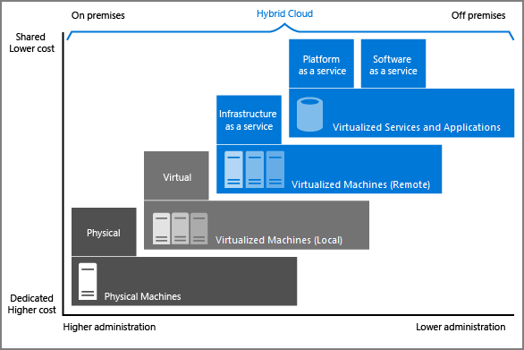
Types of clouds
Notes:
The Image illustrates several of the cloud computing concepts that are presented earlier in the session. In this example, several factors are demonstrated when you're considering where to deploy a database server in a hybrid cloud environment. As your resources move from on-premises to off-premises, your costs are reduced, and your administration requirements decrease.

Slide 17
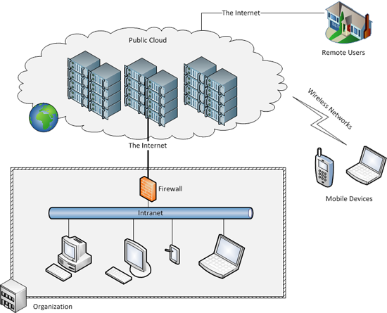
Public cloud

Slide 18
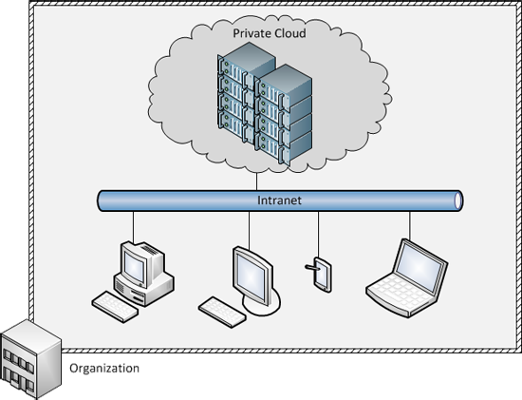
Private cloud

Slide 19
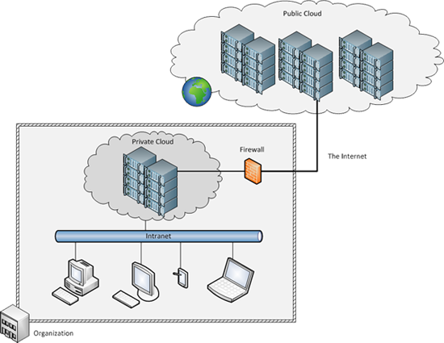
Hybrid cloud

Slide 20
Major cloud providers
-> Microsoft Azure
Compute:
Virtual Machines
Machines could run Windows or any flavors of Linux
Storage: Azure offers several storage solutions, including:
Azure Blob storage
Azure Table
Azure File Storage
Azure Cosmos DB
StorSimple

Slide 21
Auto-Scaling and Load Balancing
Auto Scaling lets you build scaling plans that automate how groups of different resources respond to changes in demand.
Types:
Manual – max-out, custom, scheduled
Automated – predictive, on demand
Eg) Festivals, sale, etc
Load Balancing Definition: Load balancing is the process of distributing network traffic across multiple servers. This ensures no single server bears too much demand. By spreading the work evenly, load balancing improves application responsiveness. It also increases availability of applications and websites for users.

Slide 22

Microsoft Learn​
Student Ambassadors
Introduction to Microsoft Azure
Microsoft Learn Student Ambassadors

Slide 23





What does Azure offer?
Be ready for the future
Build on your terms
Trust your cloud
Operate hybrid seamlessly
Microsoft Learn Student Ambassadors

Slide 24
What can I do with Azure?
Azure provides more than 100 services like VMs and other software paradigms such as intelligent bots and mixed reality
You can use the virtual machines to run your applications.
You can also use AI and machine-learning services.
In fact a good way to start is by moving your existing applications to virtual machines that run in Azure.

Slide 25
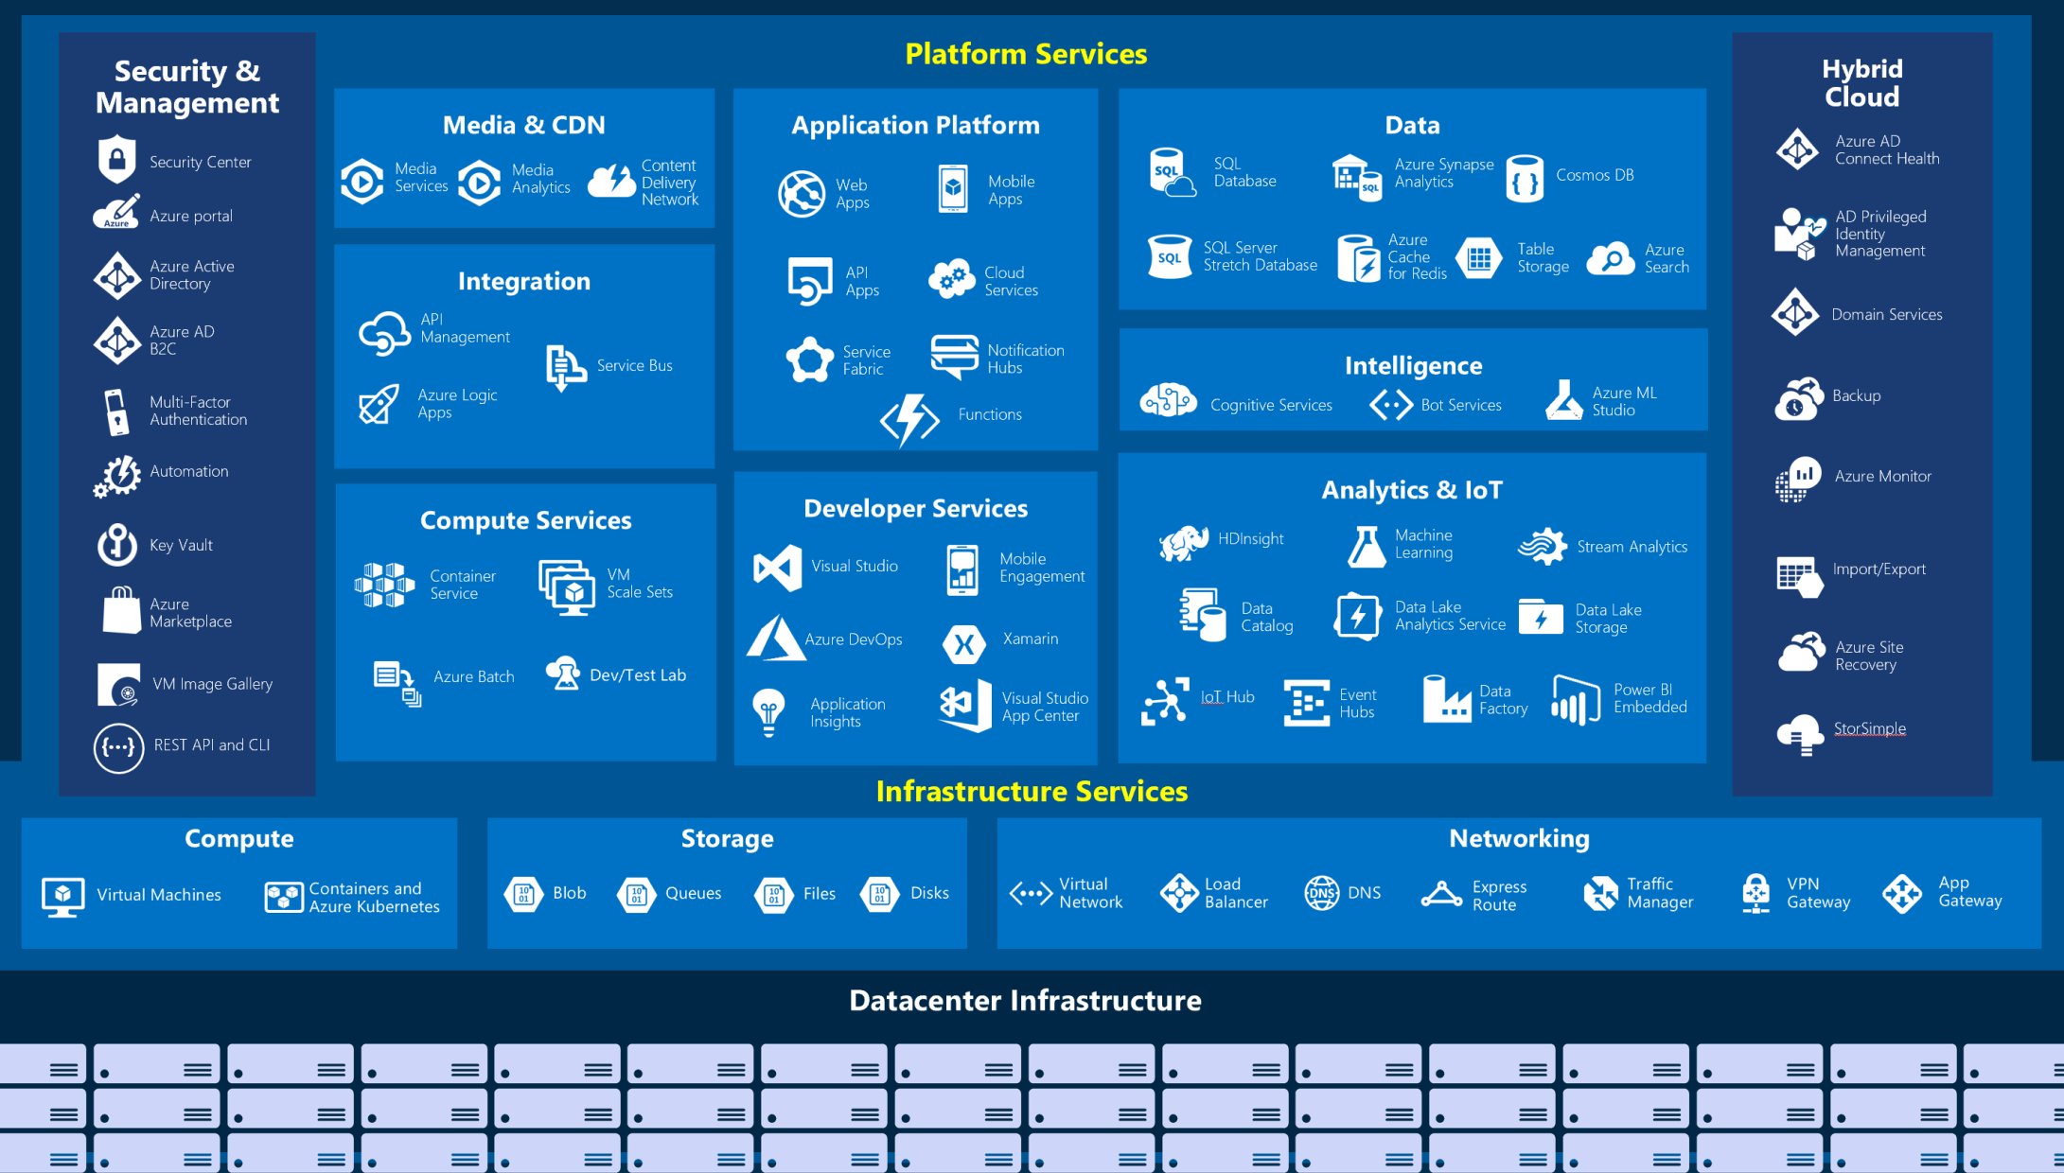

Slide 26
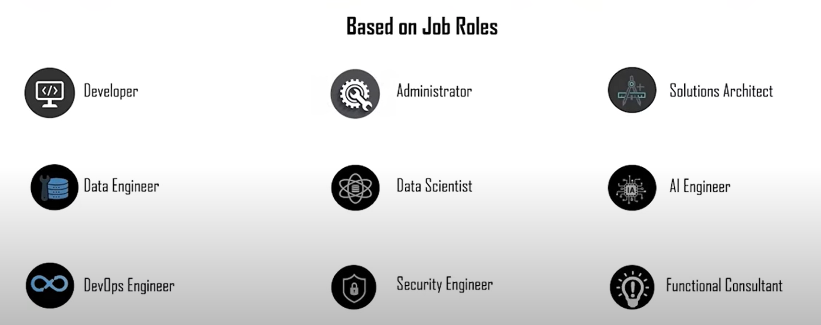
Different Job Roles in Cloud

Slide 27
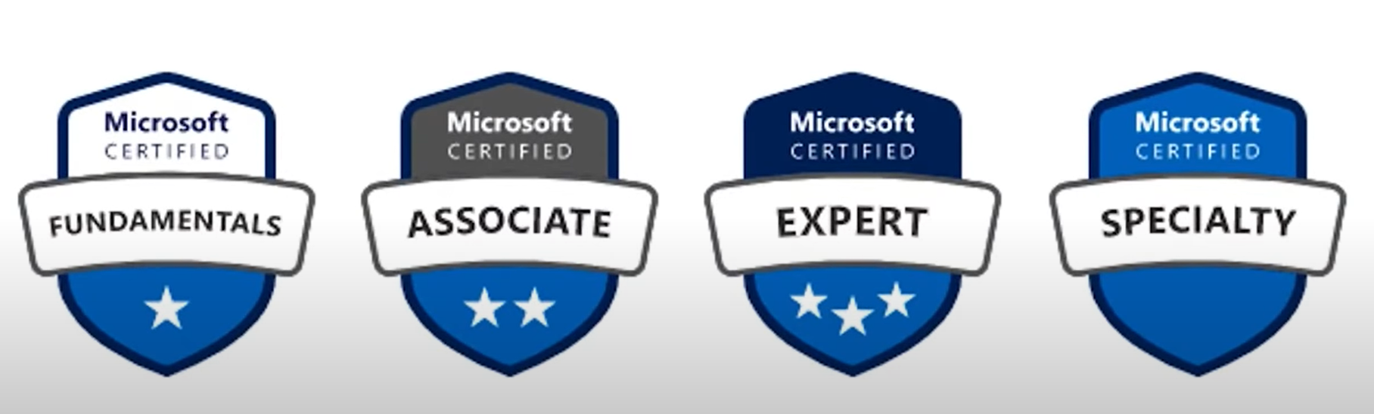
Different Certification levels

Slide 28
Study Resources
MS Learn
MS Docs
Linkedin
Github

Slide 29
My Experience

Slide 30

Contact Me
LinkedIn: Devansh Shah

Slide 31
Thank you

